Slide 1
Neighbourhood Profile:
Methil and Buckhaven
Local Authority: Fife Council

Slide 2
About this document
This document, produced by MHCLG, presents high-level data to support the Pride in Place Programme. It is intended to support Neighbourhood Boards in both identifying and evidencing local needs or trends. It does not make policy recommendations.
Background
• The Pride in Place Programme will provide 284 communities across the UK with up to £20 million of funding over the next decade. This support will help local people shape the future of their neighbourhood and deliver real change across the country.
• Data is presented across broad themes that Neighbourhood Boards may consider addressing through the programme.
• These packs do not take account of the implementation of current national or local policy interventions.
Data caveats
• The data sources in this pack are the latest available as of 1st January 2026. The metrics in this pack do not account for any boundary request changes submitted by places.
• There has been a 'point in polygon' matching exercise to provide a lookup between 2001, 2011 and 2022 DataZones to ensure historical comparability.
• There is no small area data relating to household income since 2017 so is not included in this datapack.
• Lockdown restrictions and the furlough scheme were in place at the time Census 2022 was conducted in Scotland, which may impact certain socio-economic metrics.
• The boundaries used in this data pack are based on 2011 Intermediate Zone geographies, derived from the neighbourhood names provided by the Scotland Office. Only full Intermediate Zones are included in the pack.

Slide 3
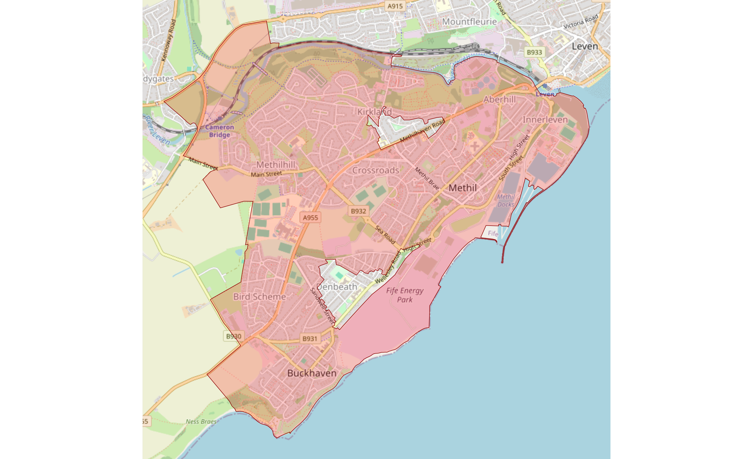
Map showing the boundary and surrounding context of Methil and Buckhaven
Contains OS data © Crown copyright 2026. OS Licence No. AC0000812160. © OpenStreetMap contributors

Slide 4
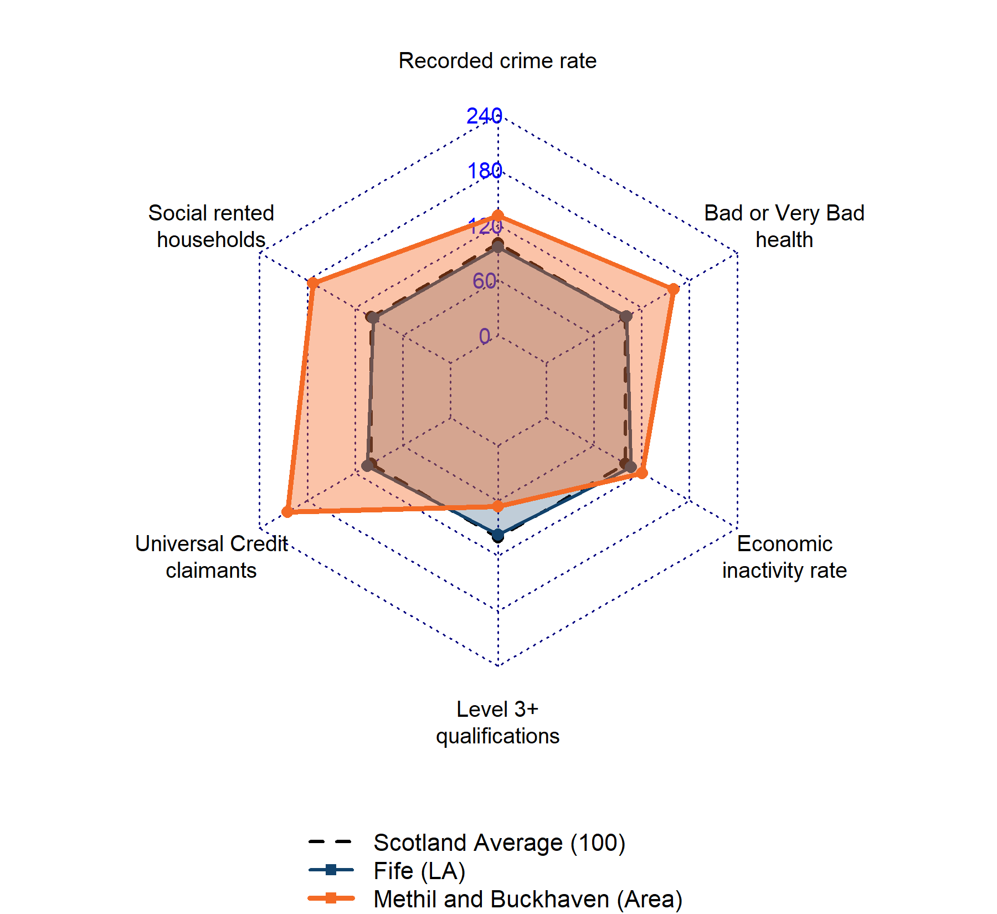
Overview of indicators
This radar chart compares the relative performance of Methil and Buckhaven across six key indicators against both the Fife Local Authority average and the Scottish National baseline. Values plotted outside the dotted black national line indicate rates higher than the national average, while values inside indicate lower rates. Note that being above or below the baseline can be positive or negative depending on the indicator. For example, higher than average Universal Credit claimants or economic inactivity represent negative outcomes, whereas higher than average educational attainment represents a positive outcome.

Slide 5
Safety, Security and Cohesion
Recorded crime type per 1,000 population
Headlines
Category | Methil and Buckhaven | Fife | Scotland
Crimes of dishonesty | 17.3 | 21.1 | 21.0
Fire-raising, vandalism etc. | 11.4 | 7.4 | 7.0
Non-sexual crimes of violence | 23.7 | 14.0 | 13.7
Other crimes | 17.5 | 8.5 | 12.3
Sexual crimes | 4.3 | 3.5 | 2.9
The most frequent category of recorded crime in Methil and Buckhaven is 'Non-sexual crimes of violence' (23.7 per 1,000 population). Local crime rates are higher than the national average in 4 categories, including Fire-raising, vandalism etc. and Non-sexual crimes of violence. When compared to the wider Fife area, the neighbourhood sees higher rates of Fire-raising, vandalism etc..
Source: Police Scotland (2025). Categories based on Scottish Government Group 1-5 classification.

Slide 6
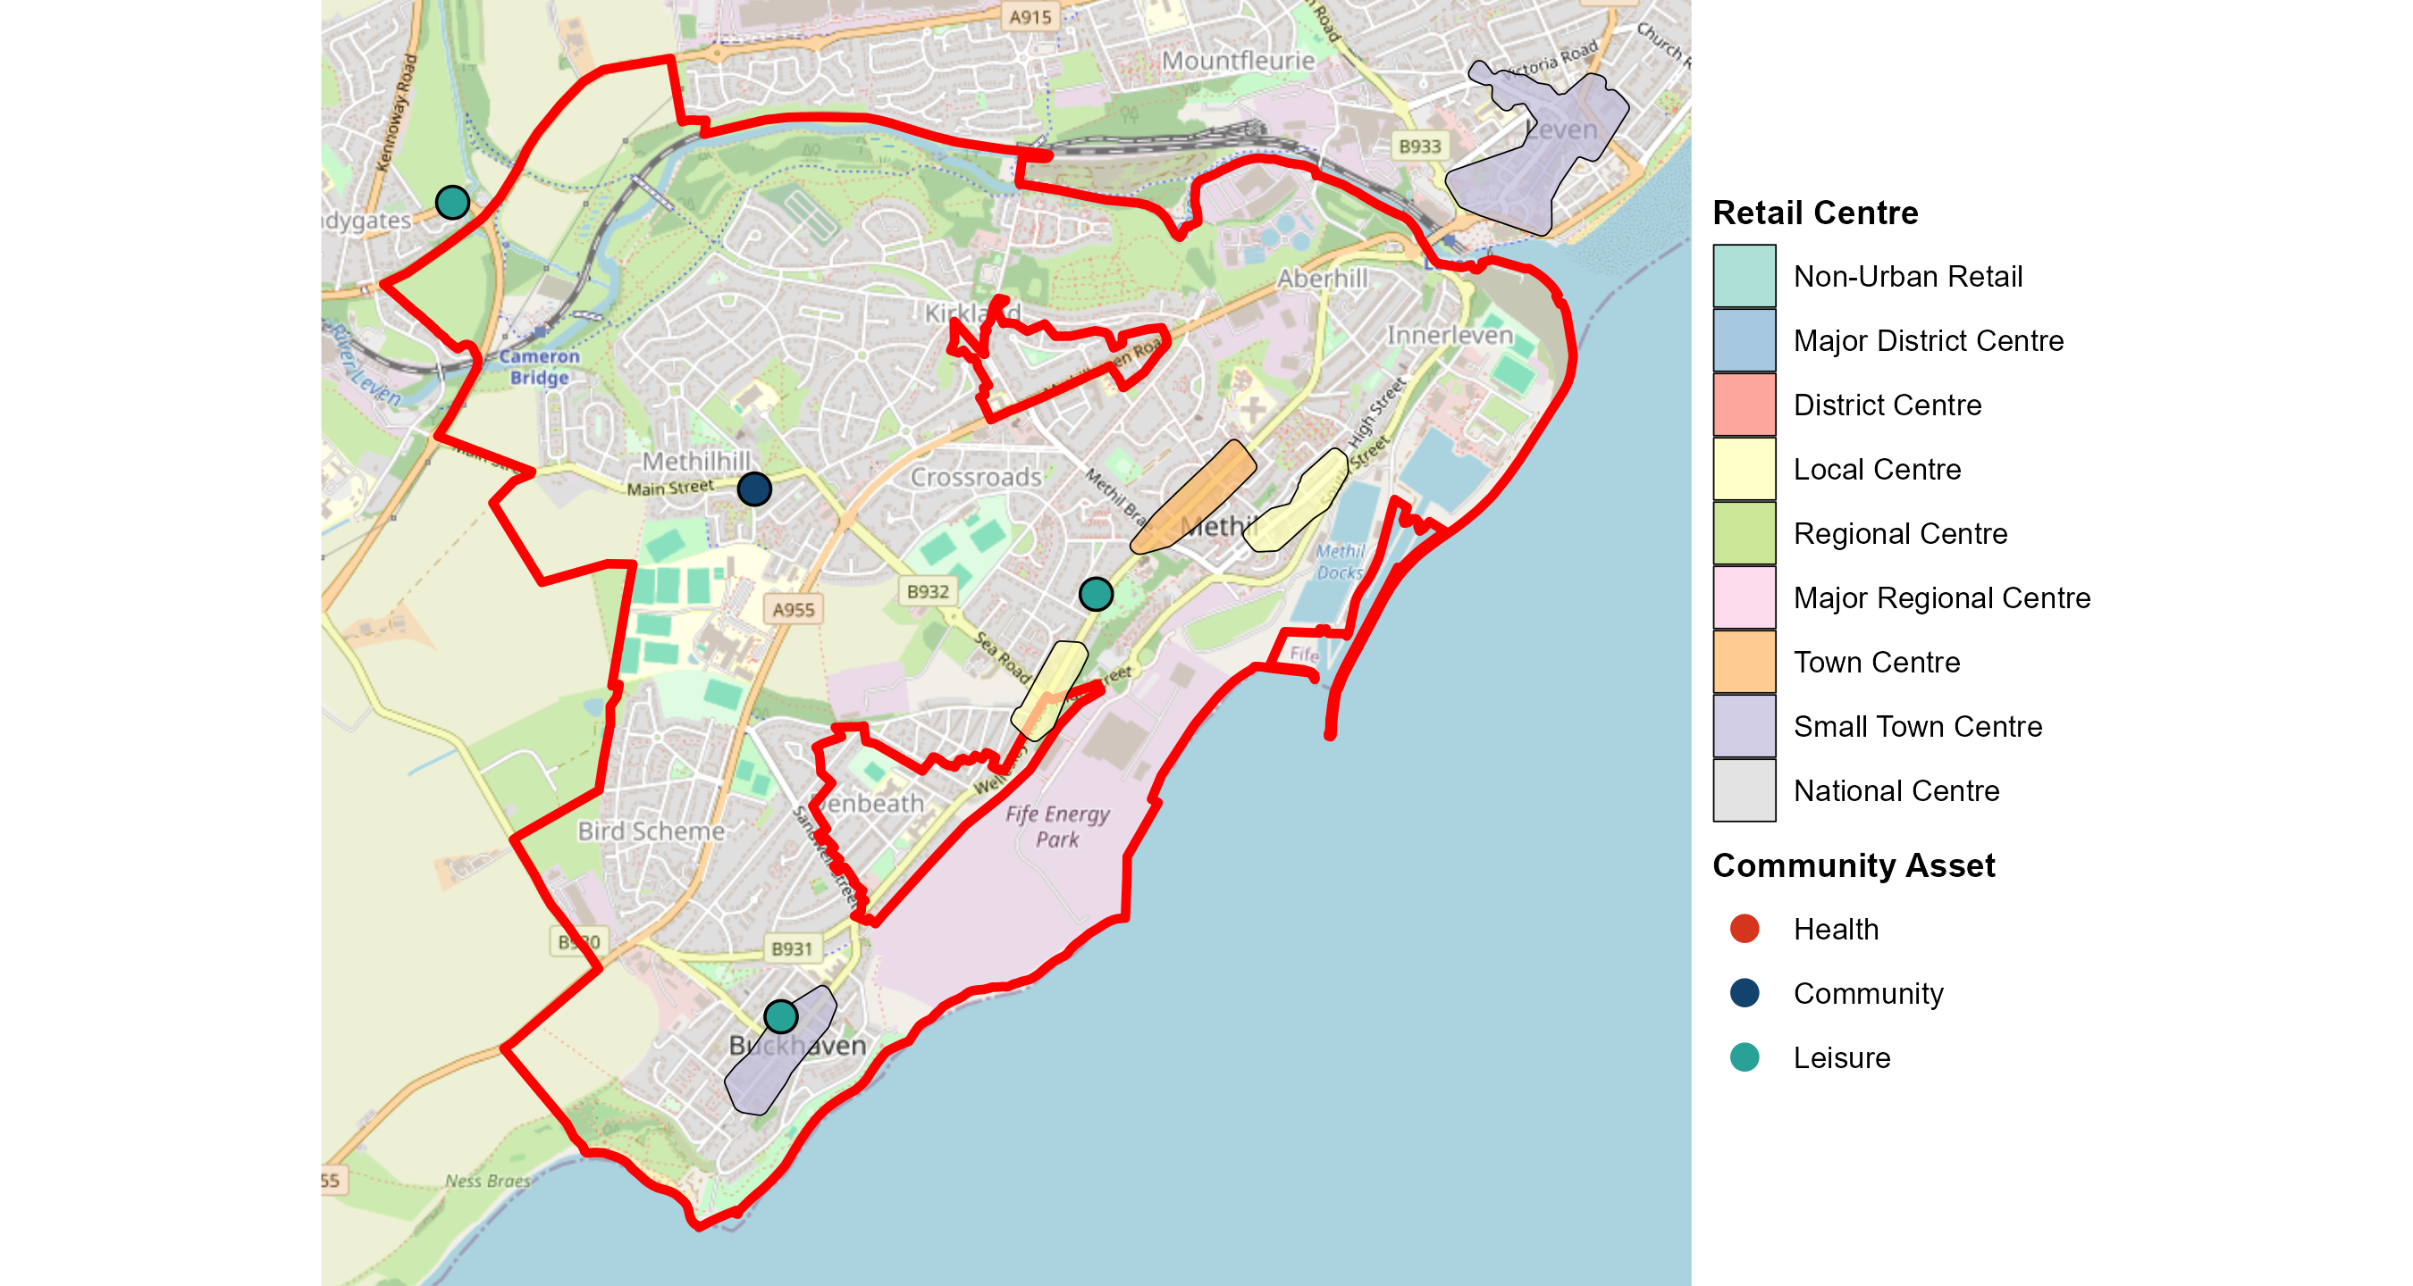
High Streets and Community Assets in Methil and Buckhaven
This map shows the location of specific community assets (Health, Community, and Leisure) and designated local retail centres in or near to Methil and Buckhaven. If no icons or shaded areas are visible, no information was found in the source datasets for this area.
Contains OS data © Crown copyright 2026. OS Licence No. AC0000812160. © OpenStreetMap contributors

Slide 7
Transport and Connectivity in Methil and Buckhaven
Headlines
On average, the most accessible essential service in Methil and Buckhaven is the Post Office. Drive times across all key services are generally shorter than the Scottish national average, indicating strong local connectivity.
Service | Methil and Buckhaven | Fife | Scotland
GP Surgery | 2.5 | 3.4 | 5.3
Retail Centre | 3.8 | 5.8 | 3.1
Primary School | 2.6 | 2.8 | 6.1
Secondary School | 4.1 | 6.9 | 2.9
Post Office | 1.9 | 2.6 | 3.9
Petrol Station | 3.9 | 4.1 | n/a
Source: Scottish Index of Multiple Deprivation (SIMD) 2020 - Geographic Access Indicators.

Slide 8
Education and Employment in Methil and Buckhaven
Headlines
Residents in Methil and Buckhaven with no formal qualifications (27.2%) are higher than the national average. UC claimant rates (0.3%) sit above the Scottish baseline.
Qualifications (16-64) (%)
Metric | Methil and Buckhaven | Fife | Scotland
Level 3+ Qualifications | 37.6 | 55.2 | 56.9
No Qualifications | 27.2 | 16.6 | 16.7
Universal Credit Claimants (%)
Inactivity by reason (%)
Area | % Rate
Methil and Buckhaven | 0.3
Fife | 0.2
Scotland | 0.2
Reason | Methil and Buckhaven | Fife | Scotland
Retired | 24.2 | 25.8 | 23.3
Long-term Sick/Disabled | 9.2 | 5.1 | 5.2
Other Inactive | 13.9 | 10.9 | 10.6
TOTAL INACTIVE | 47.2 | 41.8 | 39.1
Source: NRS Census (2022) and DWP (2026).

Slide 9
Health and Demographics in Methil and Buckhaven
Demographics & Health Overview
The largest age group in Methil and Buckhaven is Seniors (65+) (60.2%). The most prominent ethnic group is White (96.9%).
Overall, 88.9% of residents report 'Good' or 'Very Good' health. The proportion of residents in 'Bad' health is higher than the Scottish national average.
Ethnicity Profile: Methil and Buckhaven
Age Profile: Methil and Buckhaven
Youth (0-15)
8.6%
Young Adults (16-24)
6%
Working Age (25-64)
25.2%
White (96.9%)
Asian (1.8%)
Seniors (65+)
60.2%
Mixed (0.7%)
Other (0.3%)
General Health Profile (%)
Black (0.2%)
General Health Profile | Methil and Buckhaven | Fife | Scotland
Bad or Very Bad Health (%) | 11.1 | 7 | 6.9
Good or Very Good Health (%) | 88.9 | 93 | 93.1
Source: NRS Census (2022).

Slide 10
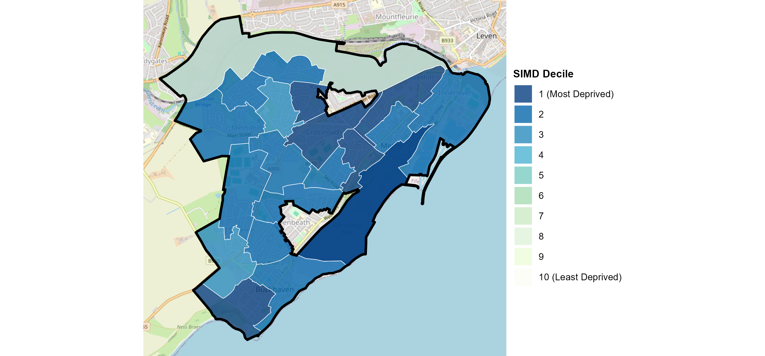
Deprivation Overview: Methil and Buckhaven
Headlines
19 out of 22 Data Zones in this neighbourhood are in the 20% most deprived areas in Scotland.
Source: Scottish Government - Index of Multiple Deprivation (SIMD) 2020.

Slide 11
Deprivation Domain Matrix: Methil and Buckhaven
The table below details the specific decile ranking for the 22 Data Zones (small neighbourhoods) that make up Methil and Buckhaven. The values represent the count of Data Zones falling into each decile across the different SIMD domains.
Decile | Access | Crime | Education | Employment | Health | Housing | Income | Overall
1 |  | 8 | 11 | 9 | 7 |  | 7 | 7
2 |  | 4 | 7 | 9 | 11 | 3 | 11 | 12
3 |  | 5 | 3 | 3 | 3 | 2 | 3 | 2
4 | 3 | 3 |  |  |  | 4
5 | 2 | 1 |  |  |  | 6
6 | 1 |  | 1 |  |  | 2
7 | 5 | 1 |  |  |  | 3
8 | 5 |  |  |  | 1 | 1 |  | 1
9 | 5 |  |  | 1 |  |  | 1
10 | 1 |  |  |  |  | 1
Source: Scottish Government - Index of Multiple Deprivation (2020).

Slide 12
Housing: Tenure, Quality and Age
Headlines
In Methil and Buckhaven, the most common property age band is '1930-1949' and the typical energy efficiency rating is D. Home ownership sits at 47.1%, compared to the national average of 63.2%.
Efficiency and Age Characteristics
Characteristic | Methil and Buckhaven | Fife | Scotland
Typical Property Age | 1930-1949 | 1950-1964 | before 1919
Typical EPC Rating | D | D | C
EPC Rated C or Better (%) | 44.2 | 42.8 | 44.8
Tenure Composition (%)
Tenure Group | Methil and Buckhaven | Fife | Scotland
Owned | 47.1 | 65.3 | 63.2
Social Rented | 38.9 | 21.9 | 22.5
Private Rented | 12.2 | 11.6 | 12.9
Rent Free | 1.7 | 1.3 | 1.4
Source: NRS Census (2022) and Scottish Government EPC Database (2024).

Slide 13
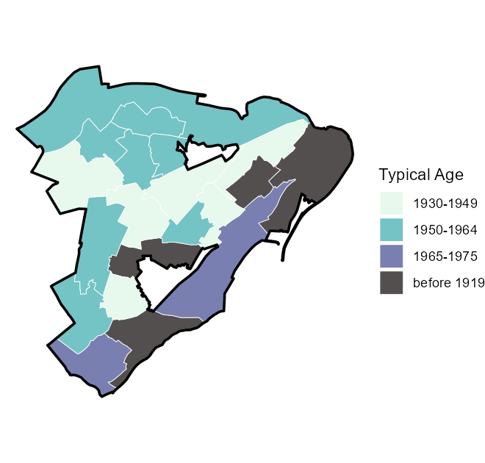
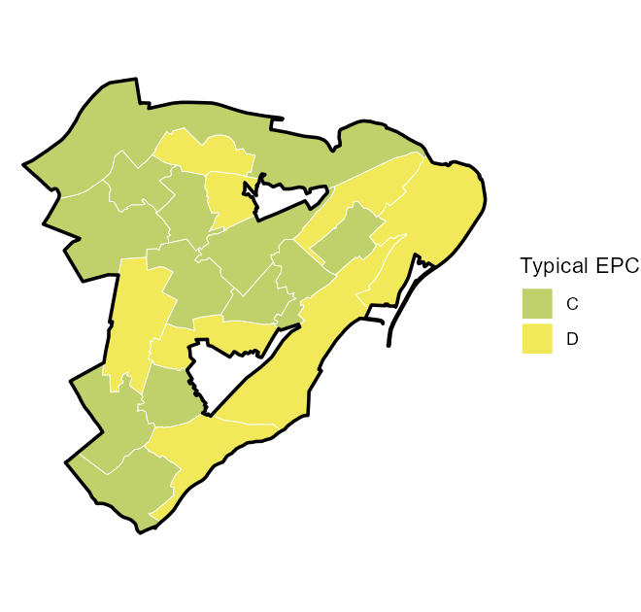
Housing: Spatial Distribution
The maps below show the distribution of housing quality and age.

